Slide 1



open the letter..
tap
tap

Slide 2
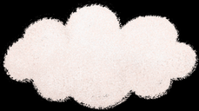

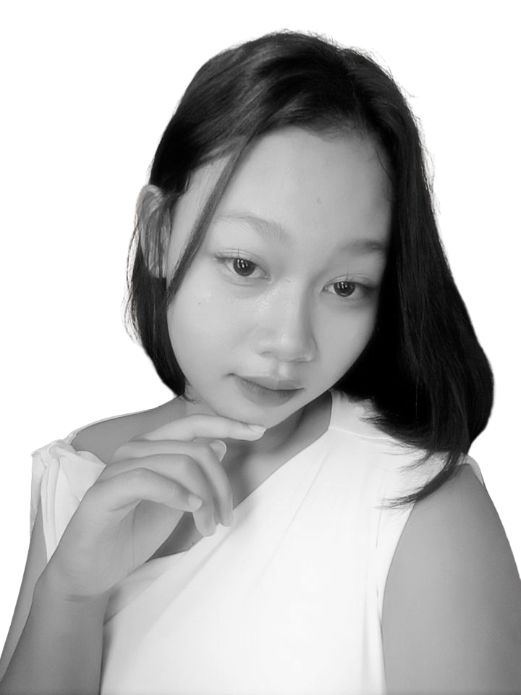


special for u !!

Slide 3





Happy Birthday
My Love

Slide 4





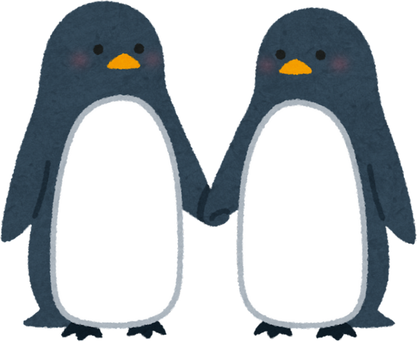

wish
to you
for us
for us
I hope you’ll always be healthy, happy, and that all your dreams slowly come true. I also hope we can always stay together, understand each other, take care of each other, and never give up on us easily. May our relationship grow stronger and last for as long as we both want.
I hope I can become the best version of myself. I hope I’ll always be healthy, that everything becomes easier for me, my blessings keep flowing, and all my dreams come true one by one. I hope I can become more mature, stronger through whatever comes my way, and never give up easily.

Slide 5


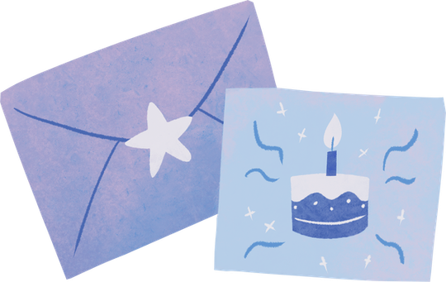
Happy Birthday..
Happy Birthday, my loveee!
I hope that in this new chapter of your life, you’ll always be healthy, happy, blessed with good things, and that everything you wish for comes true.
I'm really grateful that I got to know you and have you in my life. Thank you for being here, for staying, and for becoming such a special part of my days.
I hope we can keep being there for each other, taking care of each other, and staying together for as long as we can, my love.
Once again, happy birthday, my loveee. I hope your smile is always there, and I hope I can always be one of the reasons behind it.
— From me, Firdaus

Slide 6





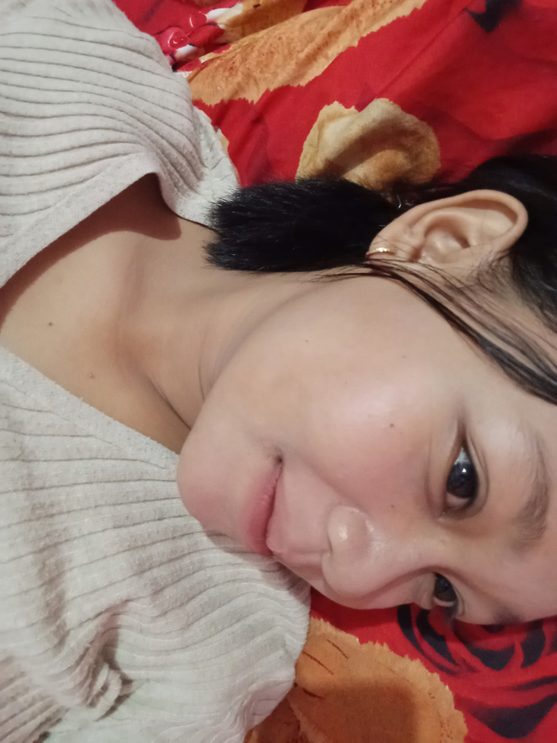

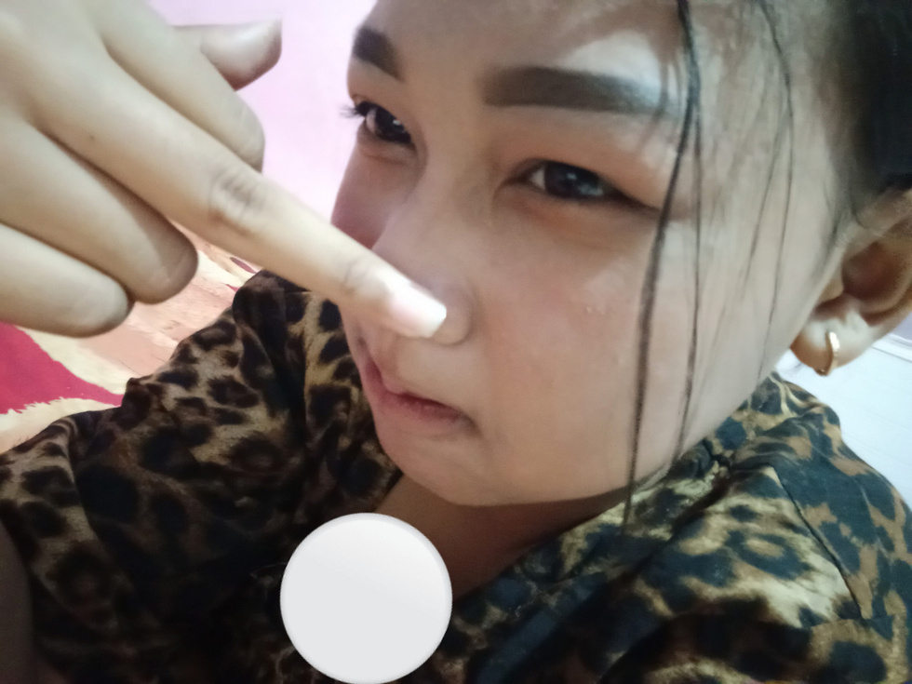
the reason why I Love U
I love the way you care about me, the way you make me feel comfortable, and how you always have such a special place in my heart. Even the little things you do sometimes make me smile to myself, xixixixiii.
I don’t know where to start explaining it. All I know is that I love you not because you’re perfect, but simply because you’re you. And somehow, out of all the people in this world, my heart chose you.
I love how you always try to understand me, even when I’m sometimes hard to understand. I love the way you make me feel appreciated, heard, and loved.

Slide 7

my love?
    She’s my beautiful girlfriend.
    She’s the person I love the most.
    She’s the one who always makes me smile.
    She’s not perfect, but she’s perfect for me.
    She’s my safest place.
    She’s my favorite person.

Slide 8
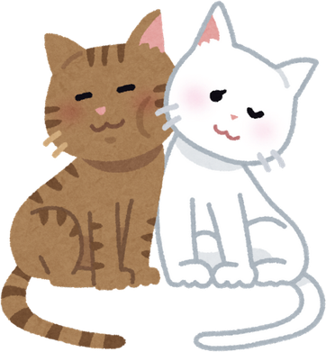

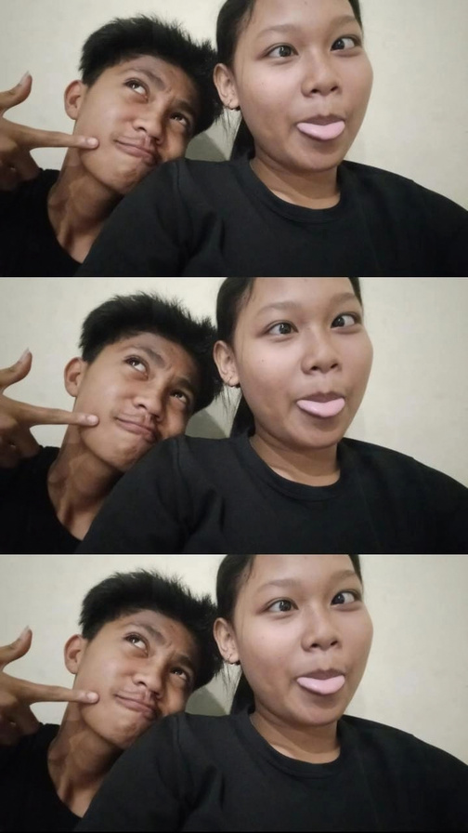
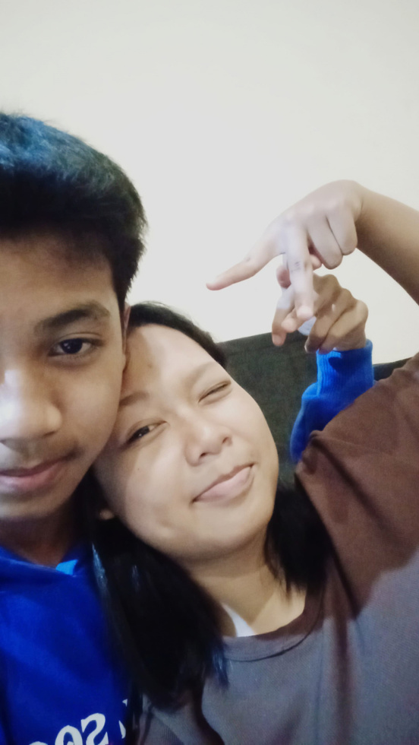



I hope we’ll always be together, my love.
Whatever we go through, I hope we’ll keep holding on to each other and never give up easily. When problems come, I hope we’ll always choose to talk things out and work through them together instead of walking away.
I want us to keep making memories, laughing together, growing together, and being there for each other for as long as we can. I hope it’s not just for now, but that one day we can look back and say, “We’re still together after everything we’ve been through.”

Slide 9


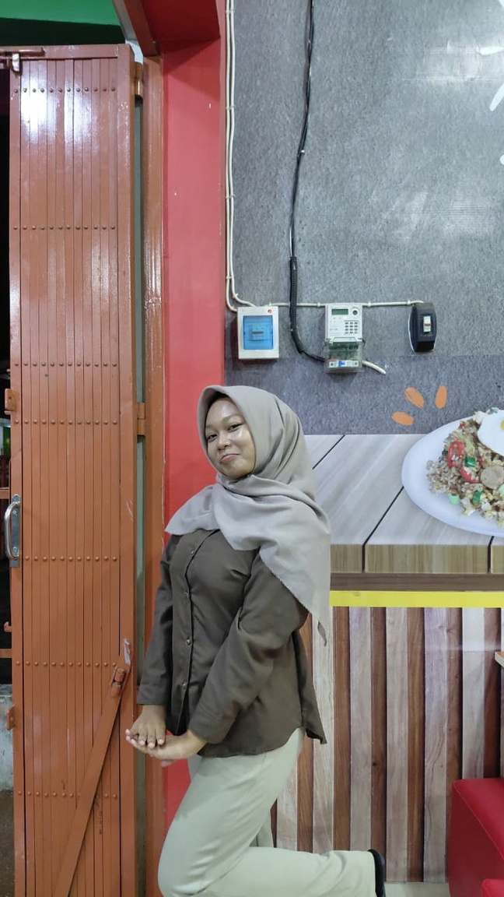
Enjoy ur 15th bday babe!!

Slide 10

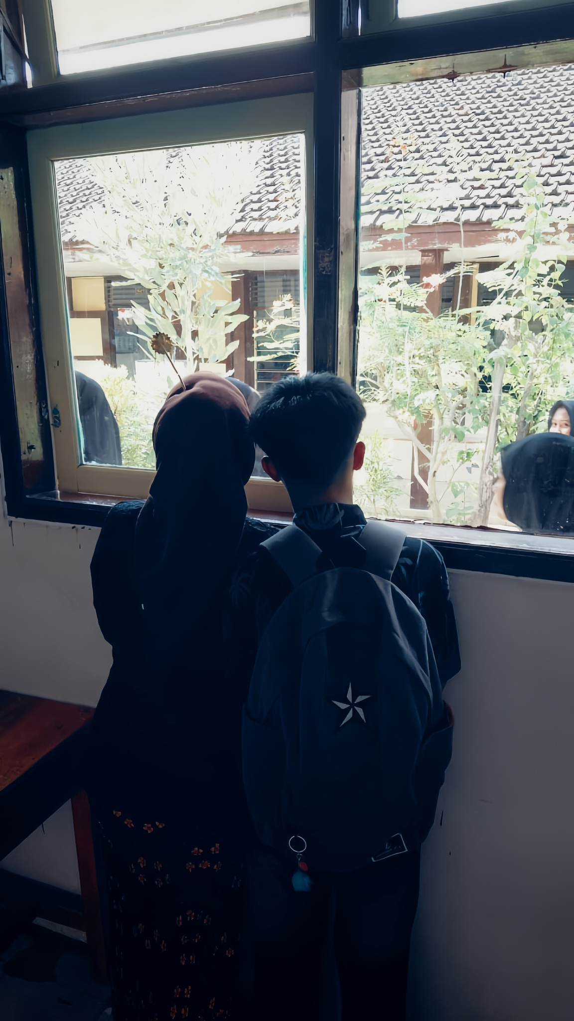
Happy Birthday

